Slide 1
An Introduction to Python
Workshop
Jason Laurie
Lecturer in Mathematics
Thomas Harvey-Ball
Lecturer in Mathematics

Slide 2
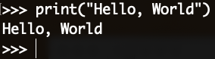
What is Python
Python is a modern, general-purpose, high-level programming language
Clean and simple
Dynamically typed
Automatic memory management
Interpreted
Two version: Python2 and Python3
Advantages
Easy to code and well designed
Documentation is tightly integrated with the code
Large standard library and a large collection of packages
“Hello World” in Python

Slide 3
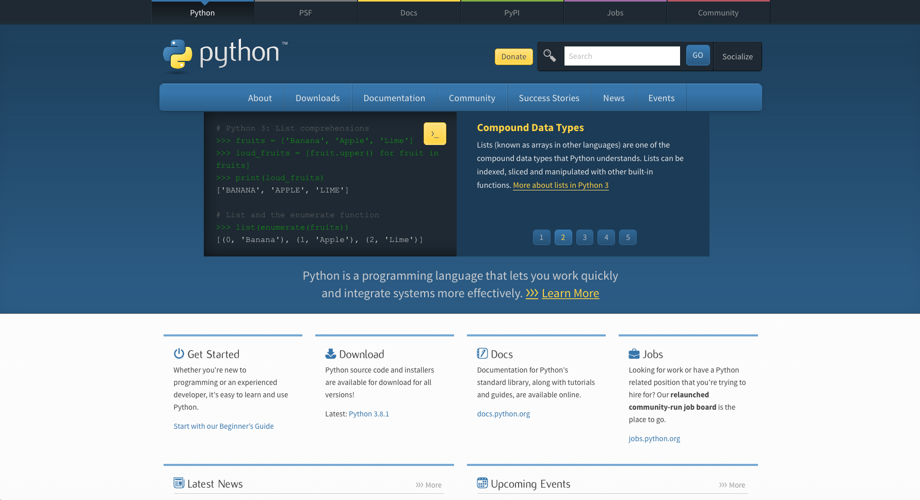
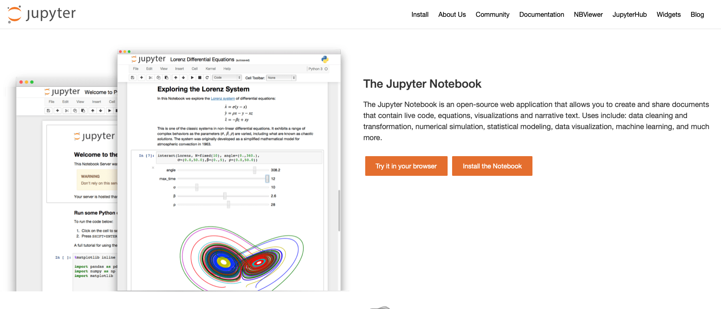
How to use Python
Install Python
www.python.org
Installation guide depending on OS (Windows, MacOS, Linux)
How to run Python code
Python interpreter:
IPython/Jupyter notebooks: www.jupyter.org
we will be using a Jupyter notebook in today’s workshop

Slide 4
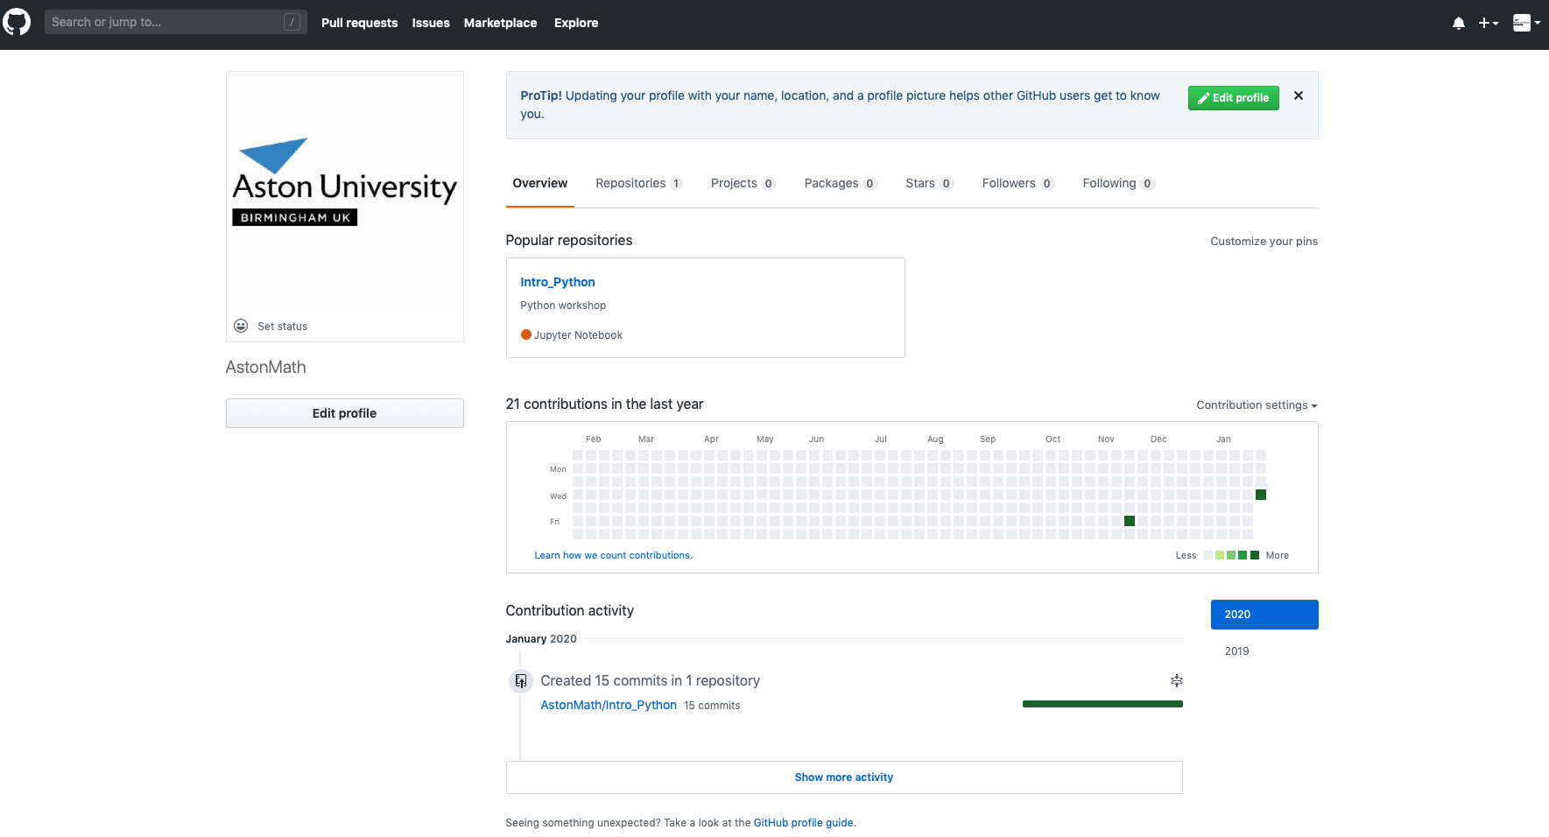
How to Access Today’s Workshop
All of our workshops will be on our GitHub page www.github.com/AstonMath

Slide 5
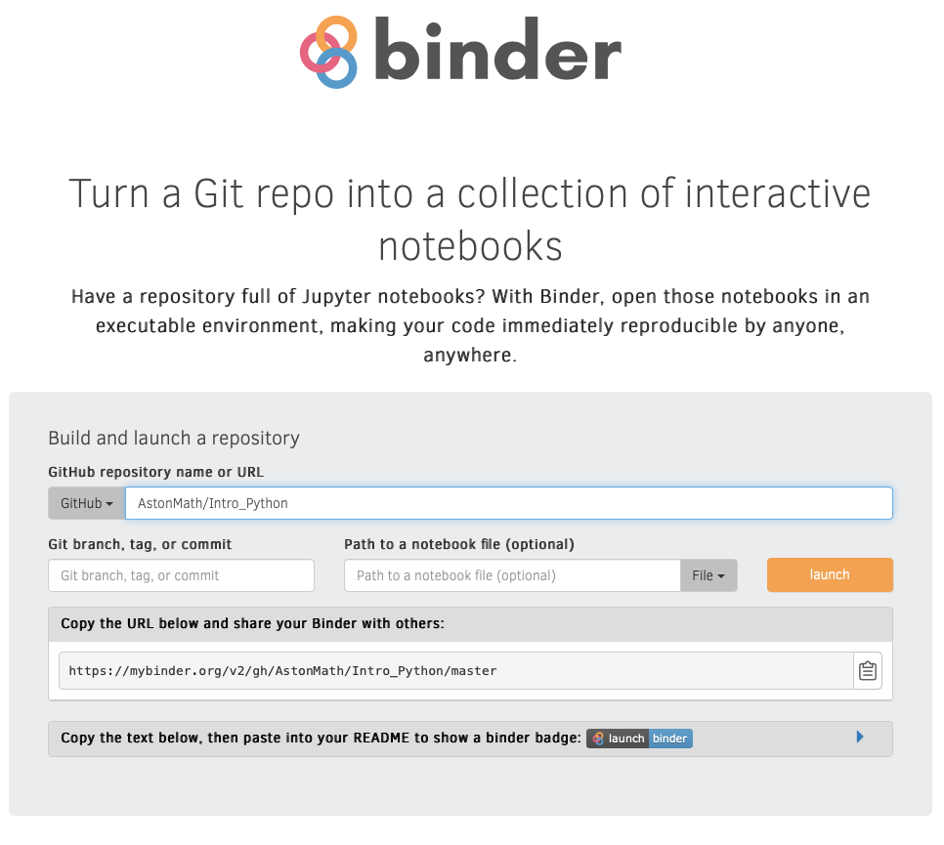
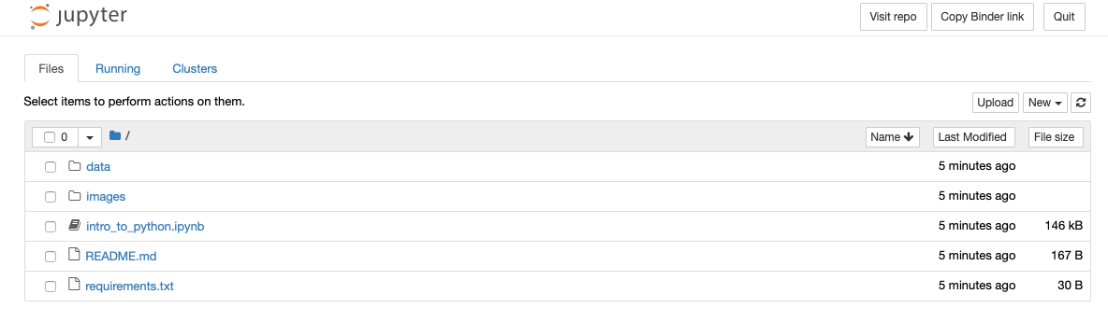
How to Access Today’s Workshop
Go to www.mybinder.org
Add “AstonMath/Intro_Python” to the Github repository name box
Click “launch”
Wait…
Click on the notebook “intro_to_python.ipynb”

